Slide 1
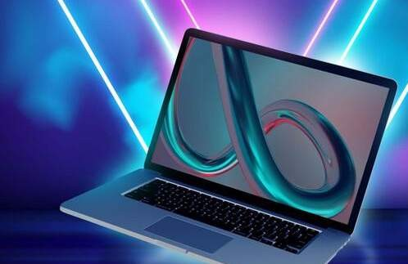
LAPTOP PRICE
PREDICTION FOR SMARTTECH CO.
CREATED BY : Nititsh Kumar Singh

Slide 2

TABLE OF CONTENTS
Project Overview and Scope
Business Problem
Business Objectives
CRISP-ML(Q) Methodology
Project Architecture
Technical Stacks
Data Collection and Understanding
Data Dictionary
Dealing with Missing values
Feature Engineering
Data Visualisations
Outlier Detection and Handling
Comparison of Model Outcomes
Hyperparameter Tuning
Most Important Features
Feature Selection and Model Building
Gradio App for Real-time Predictions
Challenges faced
Business Questions
Recommendations
Future Scope
Video Recording

Slide 3
PROJECT OVERVIEW AND SCOPE
The project overview outlines the collaboration between SmartTech
Project Overview
Co. and the data science team to develop a machine learning model for predicting laptop prices accurately.
The scope of the project includes exploring the dataset, pre- processing the data, engineering meaningful features, developing and fine-tuning machine learning models, implementing a mechanism for real-time predictions, and presenting findings and insights to SmartTech Co. stakeholders.
Project Scope

Slide 4

BUSINESS PROBLEM
The business problem is to develop a robust machine learning model that accurately predicts laptop prices based on diverse specifications. This will enable SmartTech Co. to strategically position its laptops in the market and stay competitive.

Slide 5

Develop a precise pricing model that accurately predicts laptop prices based on various features
BUSINESS OBJECTIVES
Understand how different features contribute to pricing to strategically position SmartTech Co.'s laptops in the market
Assess the impact of brand reputation on pricing to enhance brand perception and market demand

Slide 6
CRISP-ML(Q) METHODOLOGY
To guide ML practitioners through the development life cycle, the Cross-Industry Standard Process for the development of Machine Learning applications with Quality assurance methodology (CRISP-ML(Q)) was recently proposed
Data understanding
Modeling
Deployment
Business and Data Understanding
Data Preparation
Evaluation

Slide 7
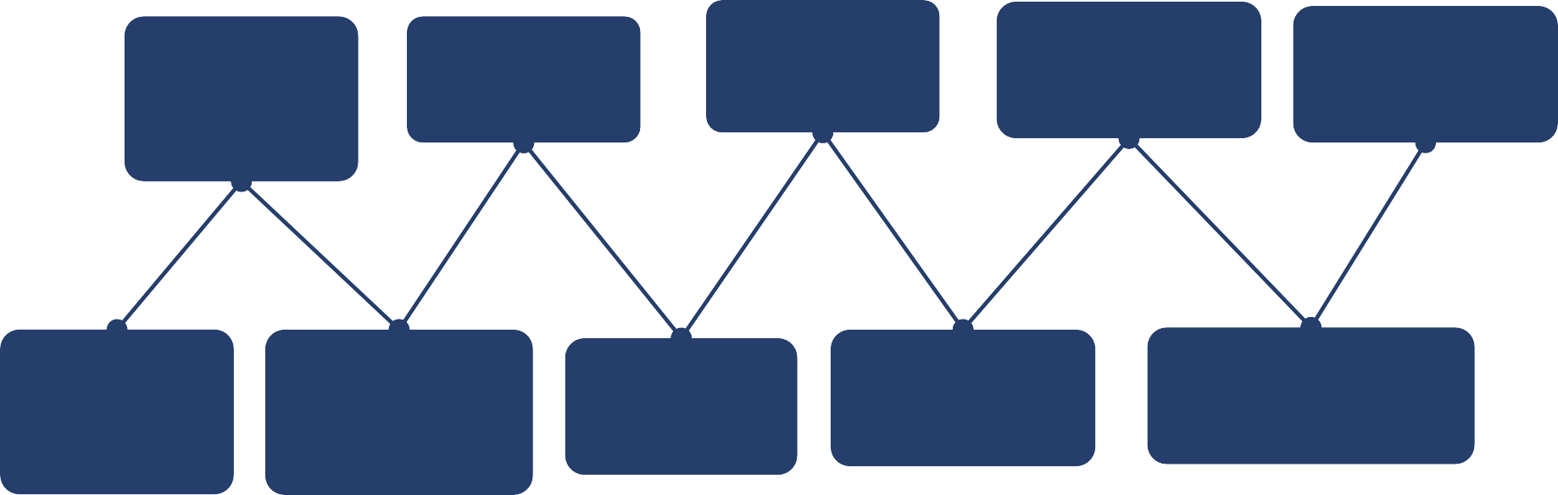
PROJECT ARCHITECTURE
Data Preprocessing
Feature
Engineering
Performance Evaluation
Real-time Predictions
Dataset
Importing
Data Exploration and Understanding
Model Building
Hyper-Paremeter Tuning
Importing Libraries
Data
Visualisation

Slide 8









TECHNICAL STACKS

Slide 9
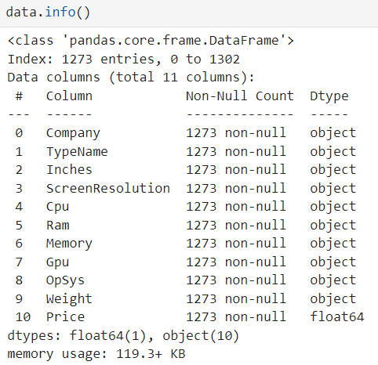
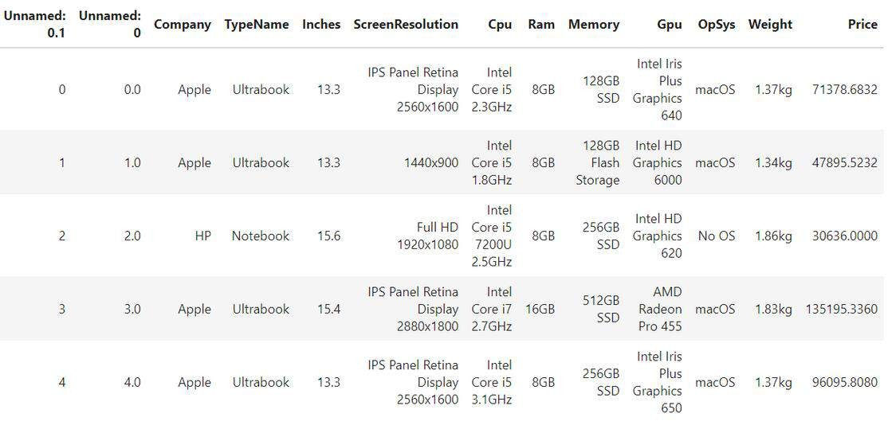
DATA COLLECTION AND UNDERSTANDING
The dataset consists of 1303 rows and 13 columns
11 Columns left after 'Unnamed: 0.1' and
'Unnamed: 0' columns were dropped

Slide 10

DATA DICTIONARY
Columns/Features
Description
Company
Name of the laptop brand
TypeName
Type of the laptop used for various applications
Inches
Laptop Screen Size
ScreenResolution
Resolution of laptop screen in dimension pixels and type of screen
Cpu
Cpu brand and Type
Ram
RAM size in GB
Memory
Total Memory
Gpu
GPU brand and Type
OpSys
Operating system
Weight
Weight of laptop in kgs
Price
Price of laptop

Slide 11
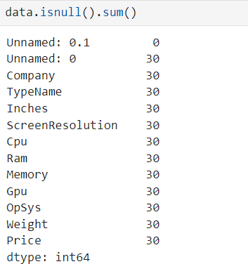
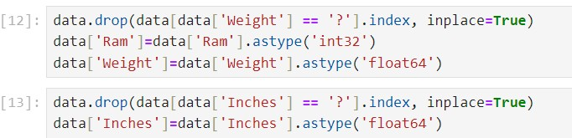
DEALING WITH MISSING VALUES
Removed the null values as they were very less compared to shape
The columns “Weight” and “Inches” consists of garbage values might be due to data entry errors; those values were dropped

Slide 12
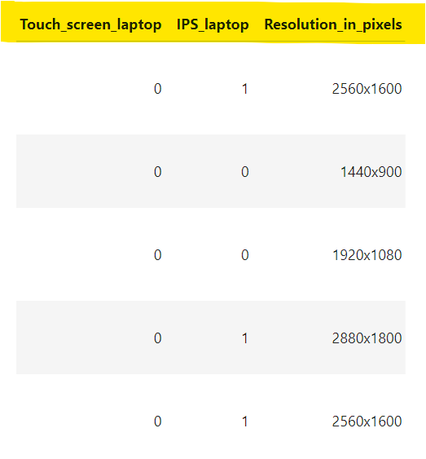
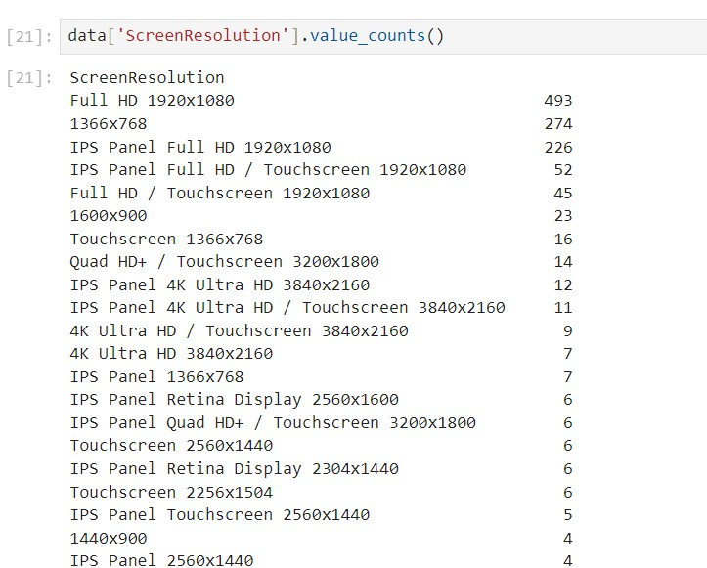
FEATURE ENGINEERING
The 'ScreenResolution' column has been divided into three seperate columns i.e 'Resolution_in_pixels', 'Touch_screen_laptop' and 'IPS_laptop' as most laptop screens are belong to these types

Slide 13
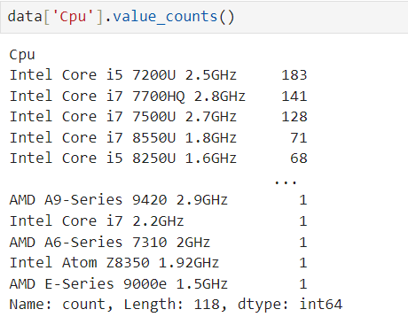
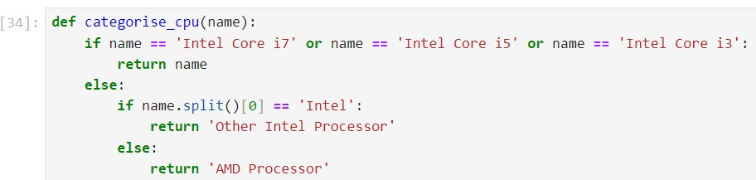
CONTD...
Various types of CPUs are available in the market, and so they were divided into the most famous one such as Intel and less famous ones are separated as others.

Slide 14
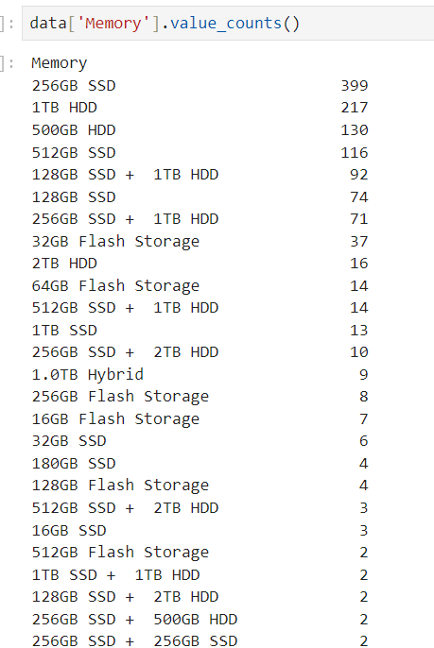
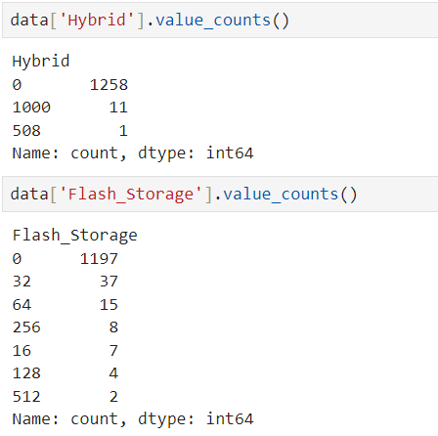
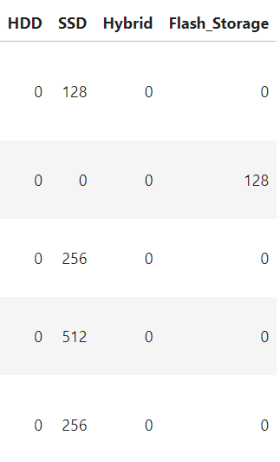
CONTD...
The memory column has been transformed into four available types 'HDD', 'SDD', 'Hybrid' and 'Flash Storage'
But, the columns ‘Hybrid’ and ‘Flash Storage’ have most 0 values, so they are dropped

Slide 15
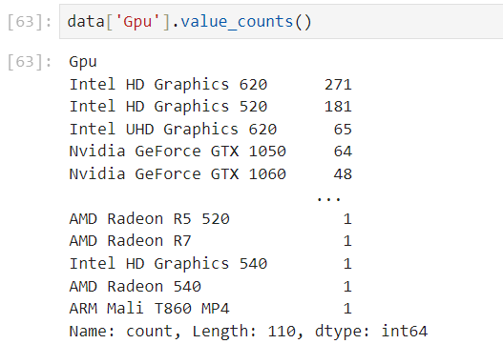
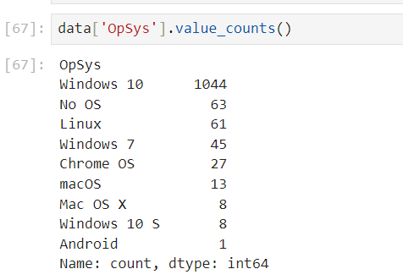
CONTD...
Similarly, so many GPUs are there in market so only first first is kept as brand name to generalise better
The Operating Systems are categorised under ‘Windows, ‘Mac’, and ‘Others’.

Slide 16
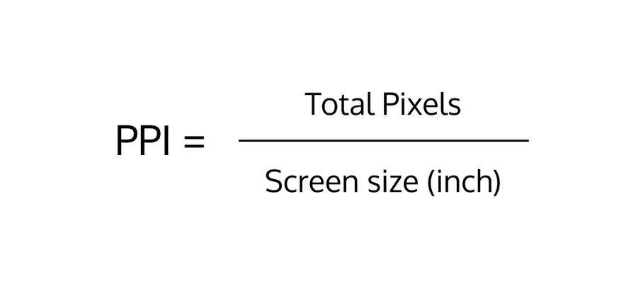

CONTD...
PPI (Pixels Per Inch) measures the pixel density of a display, indicating the number of pixels present per inch of screen space. It is calculated by dividing the diagonal resolution of a display by its diagonal size. PPI is important for determining the sharpness and clarity of images and text on screens. So, this feature has been added to predict laptop price more clearly.

Slide 17

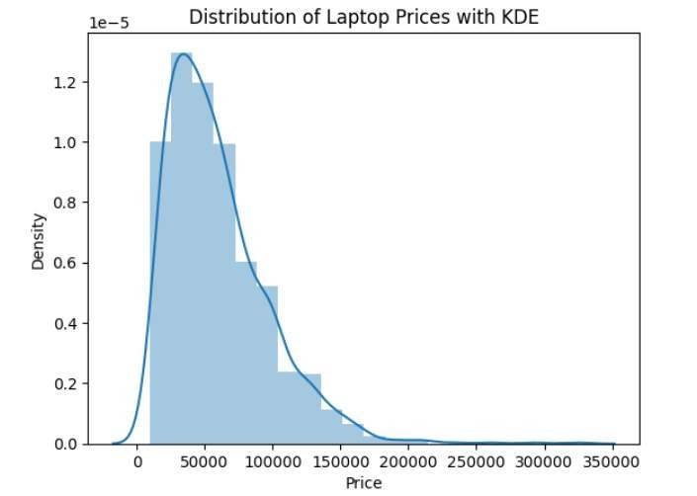
DATA VISUALISATIONS
The laptop prices mostly range between 10,000 to 2,00,000. However, most laptops cost 50,000. This plot also shows that the distribution of laptop prices is right skewed or positive skewed.

Slide 18

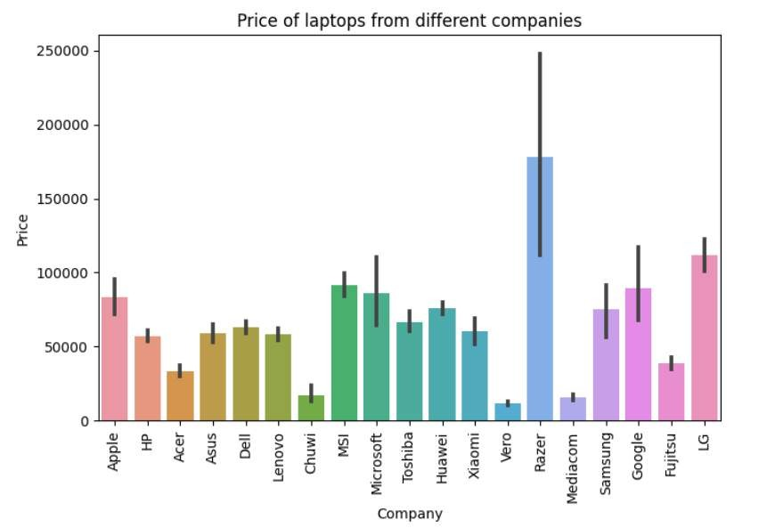
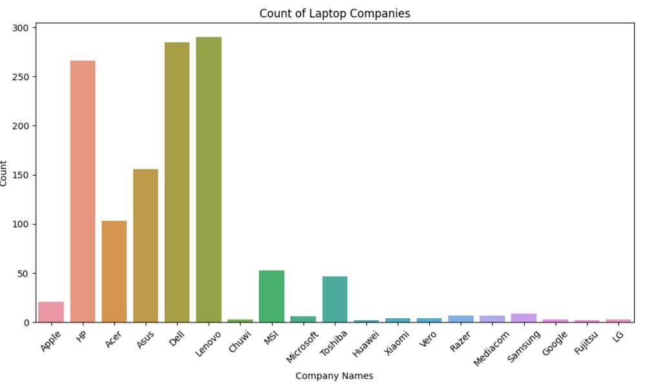
CONTD...
Razer laptops are most expensive. But, they are sold less. But, the mid-range laptops with affordable prices are sold most. Similarly, Lenovo, Dell, Asus, Acer, and HP fall in this category.

Slide 19
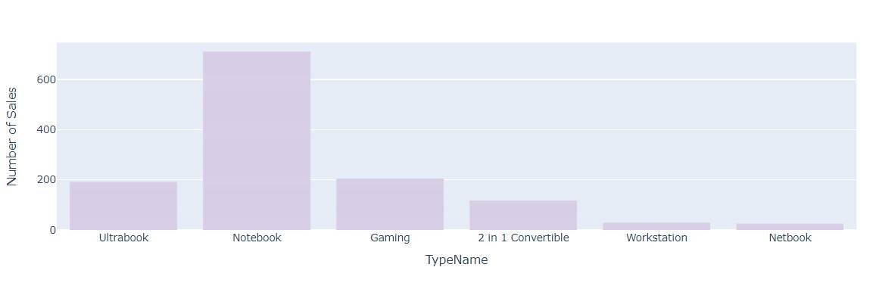
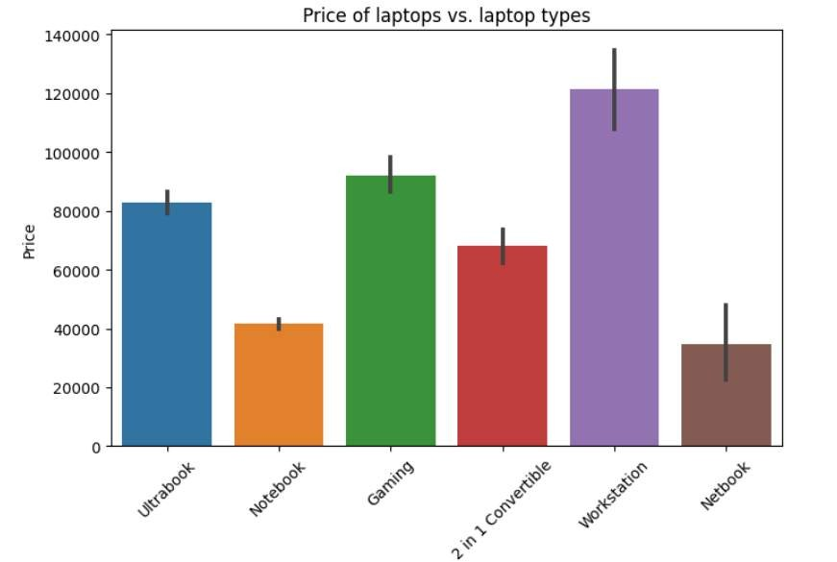
CONTD...
Notebook laptops are sold the most, followed by Gaming and Ultrabook.
Here, Notebooks have affordable pricing of about 40,000 and hence they are sold most. Workstation, on the other hand, are the most expensive laptops that are sold less.

Slide 20

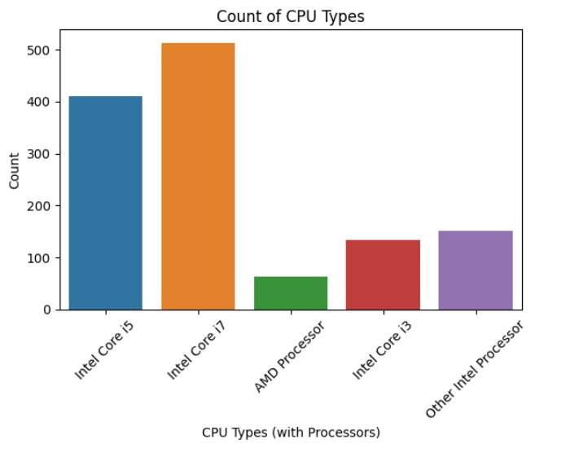
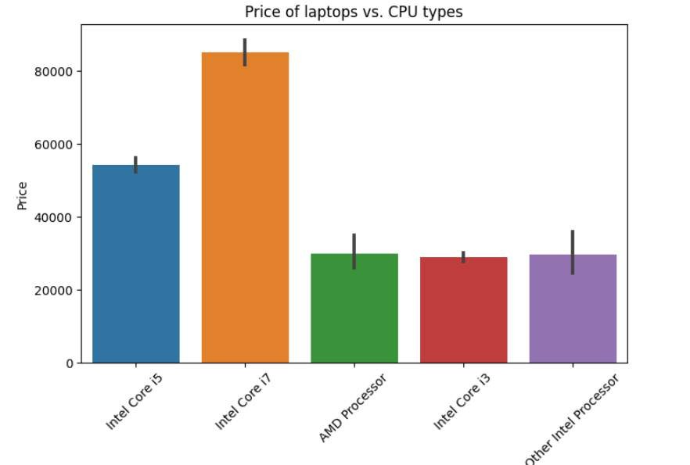
CONTD...
More number of intel core i7 processors are sold in the market compared to other different processors and brands. Similarly, it is also the most costly one, followed by intel core i5.

Slide 21
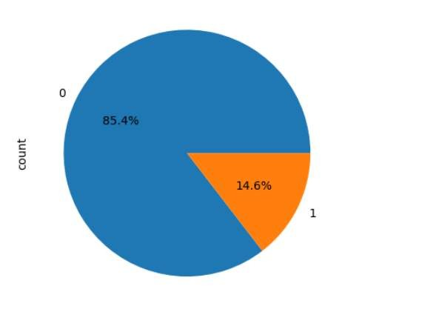
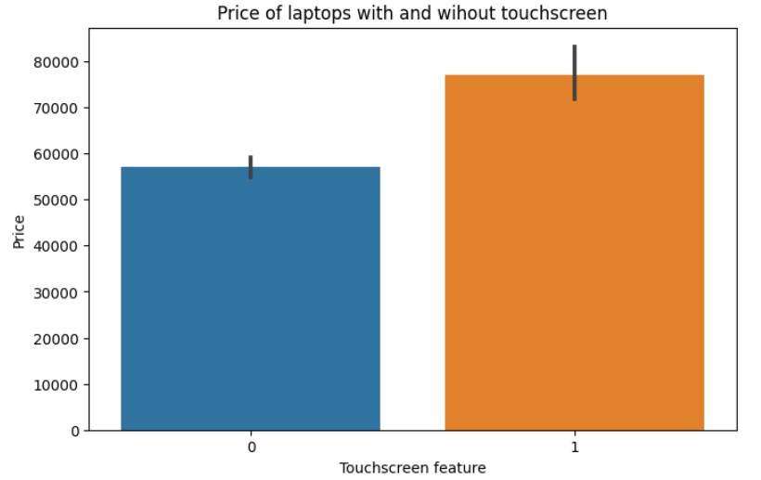
CONTD...
Most of the laptops sold are without touchscreen feature. Also, laptops with touchscreen feature are more expensive than without. Therefore, it might be possible that customers opt for cheaper option.

Slide 22
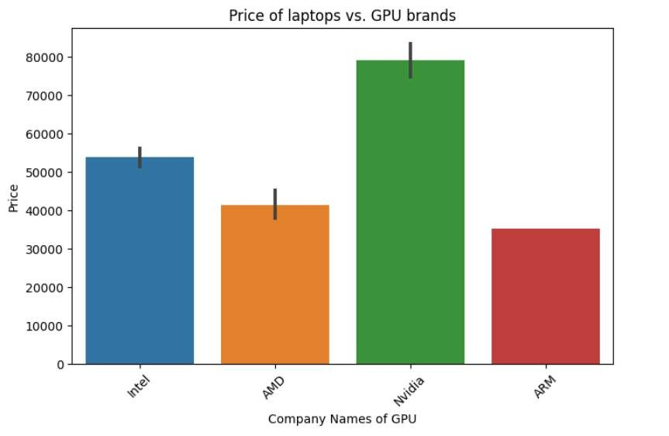
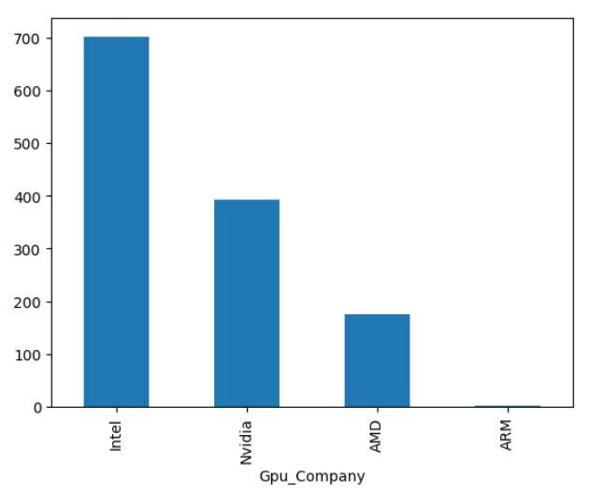
CONTD...
Nvidia Gpus are most expensive followed by Intel and AMD. On the other hand, Intel Gpus are most demanded by customers followed by Nvidia and AMD.

Slide 23
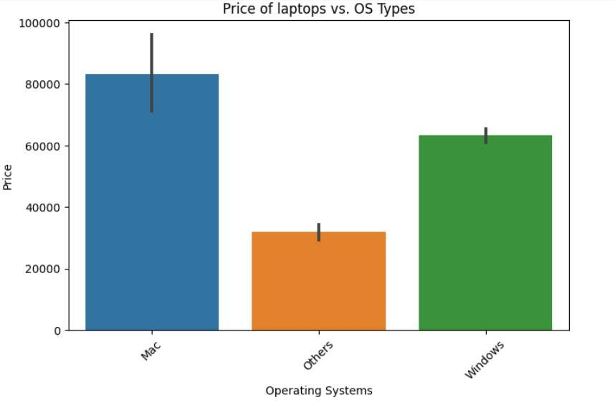
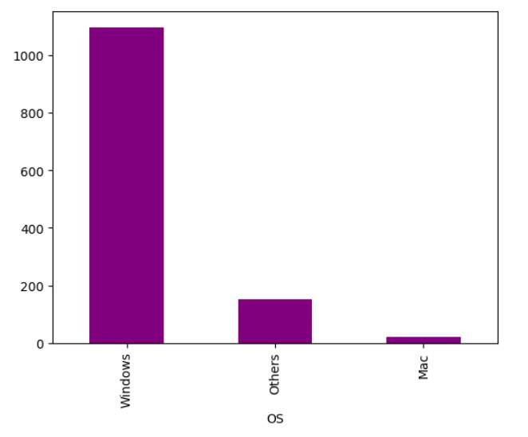
CONTD...
Mac OS are the most expensive, followed by Windows, and Others. Others mainly include No OS, Linux, Chrome, OS, etc. However, the most sold laptops have Windows OS. Mac OS can be afforded by few customers.

Slide 24
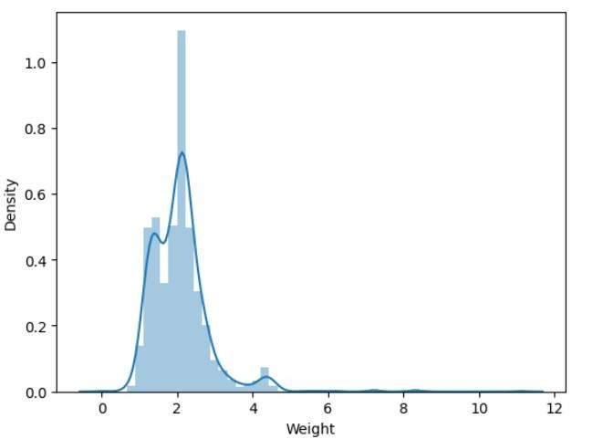
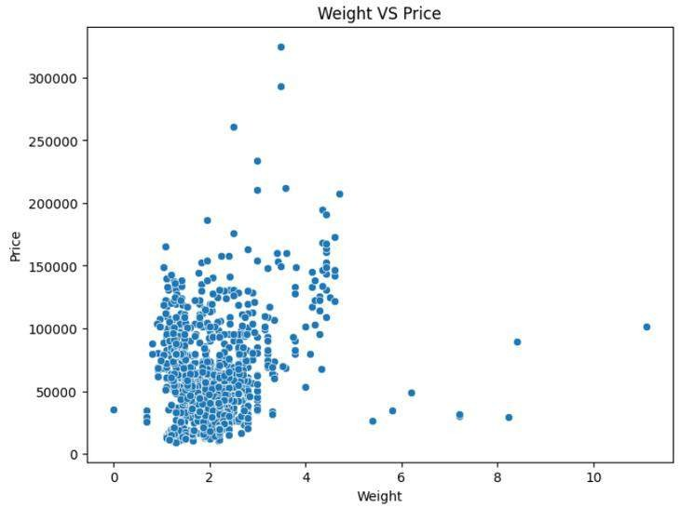
CONTD...
Most laptops weigh 2 kgs. The range is from 0 to 4 kg. However, no clear relationship can be observed between weight and price.

Slide 25
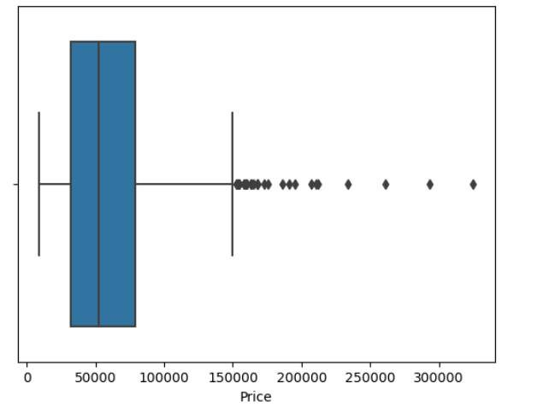
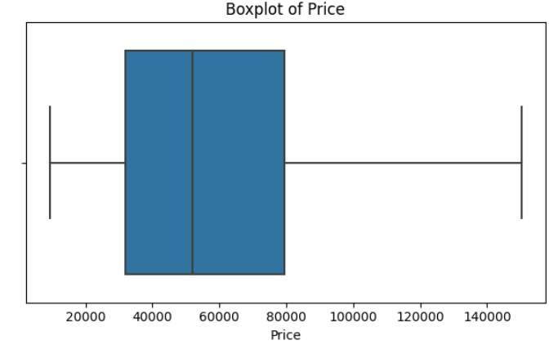
OUTLIER DETECTION AND HANDLING
Outliers are detected with boxplot. Then IQR method was applied
with clipping to remove outliers.

Slide 26

COMPARISON OF MODEL OUTCOMES
Model Name | R2 score | RMSE
Linear Regression | 0.7959 | 0.2778
KNN Regressor | 0.7983 | 0.2761
Decision Tree Regressor | 0.8077 | 0.2696
SVR | 0.8075 | 0.2697
Random Forest Regressor | 0.8555 | 0.2336
Gradient Boosting Regressor | 0.7875 | 0.2834

Slide 27
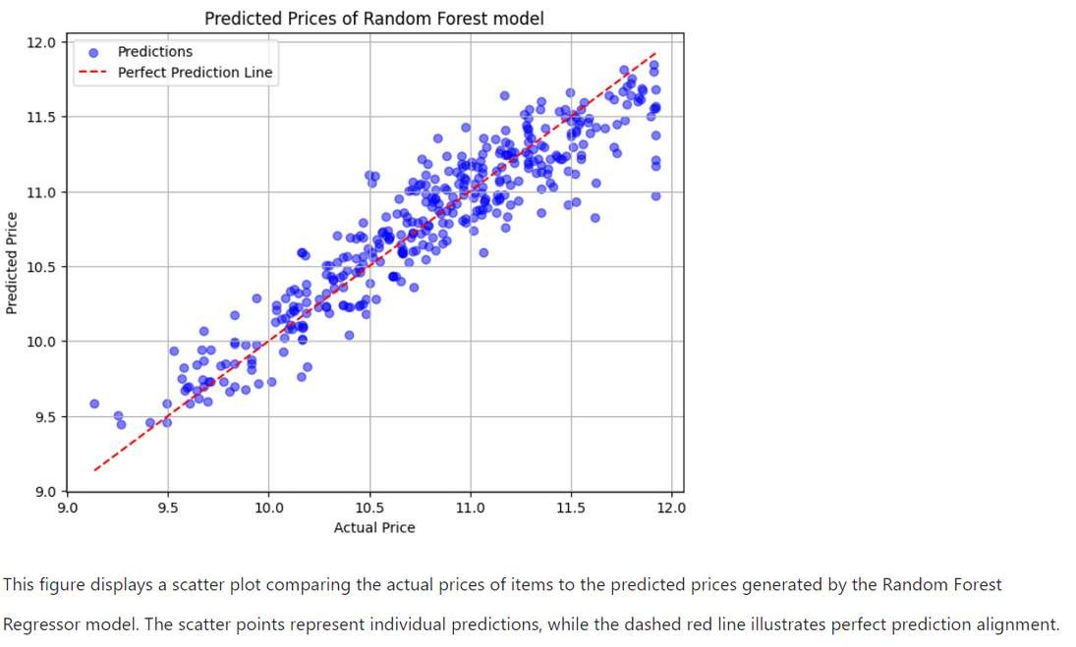
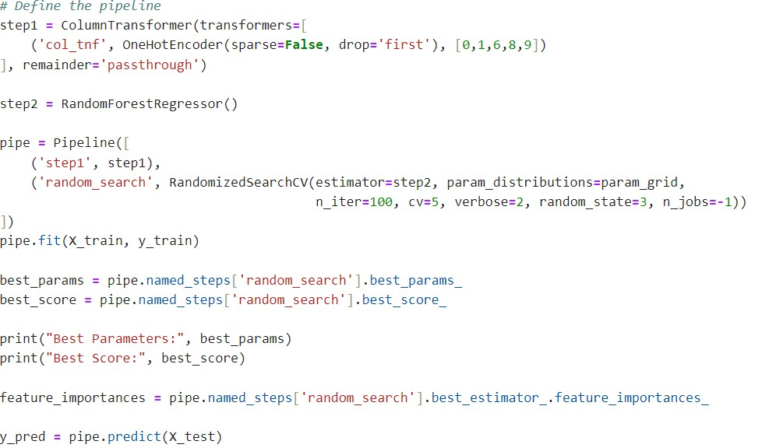
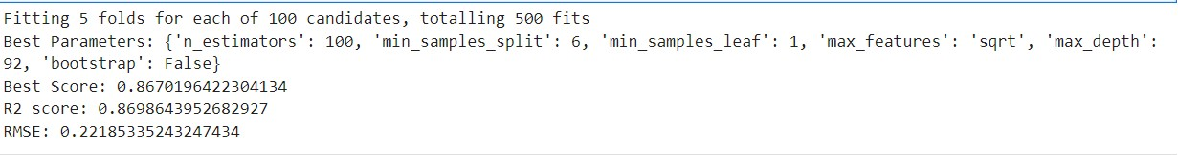
HYPERPARAMETER TUNING
RandomizedSearchCV is used for hyperparameter tuning because it efficiently explores a wide range of hyperparameter combinations by sampling from specified distributions, making it suitable for large parameter spaces. It can provide good results with fewer iterations compared to GridSearchCV, especially when computational resources are limited.

Slide 28
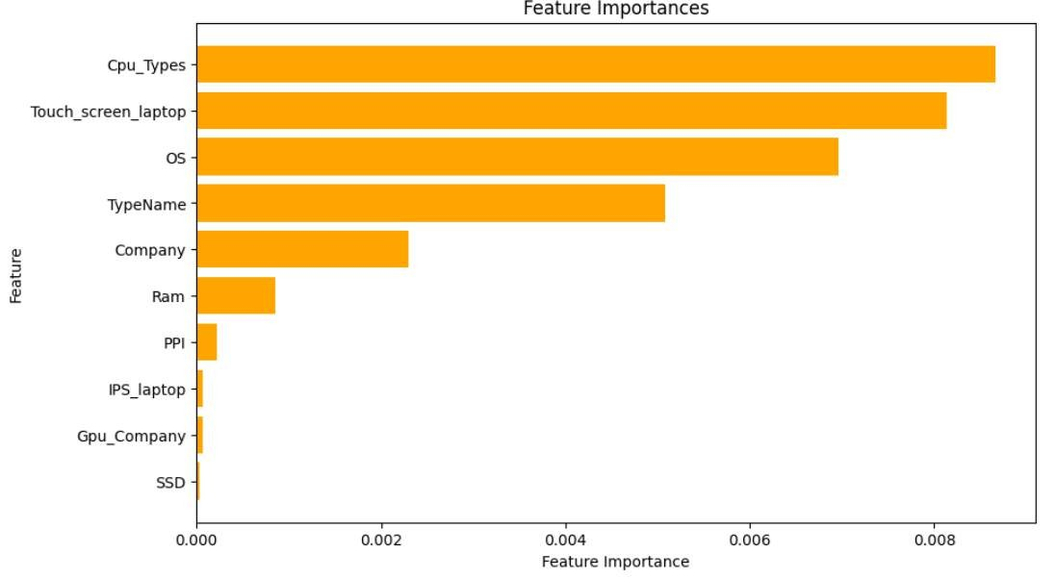
MOST IMPORTANT FEATURES

Slide 29
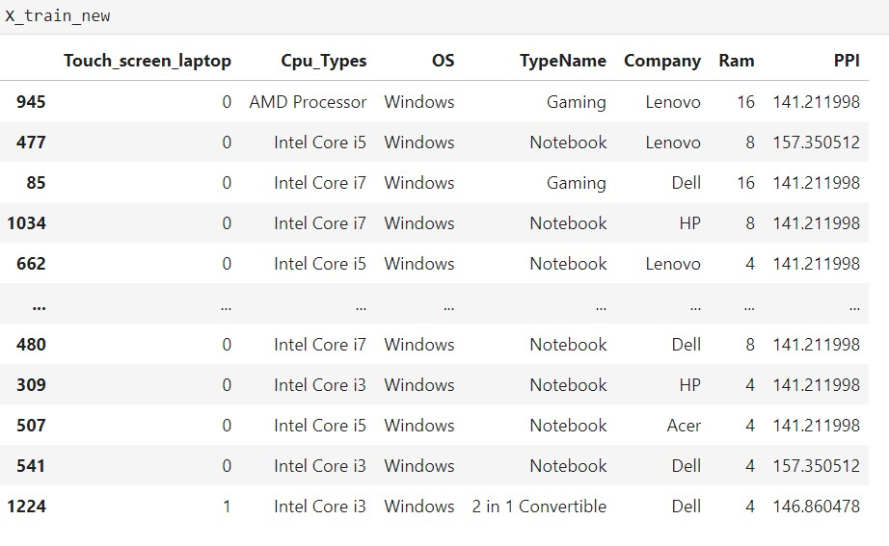
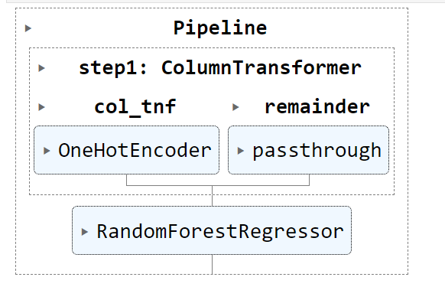
FEATURE SELECTION AND MODEL BUILDING

Slide 30
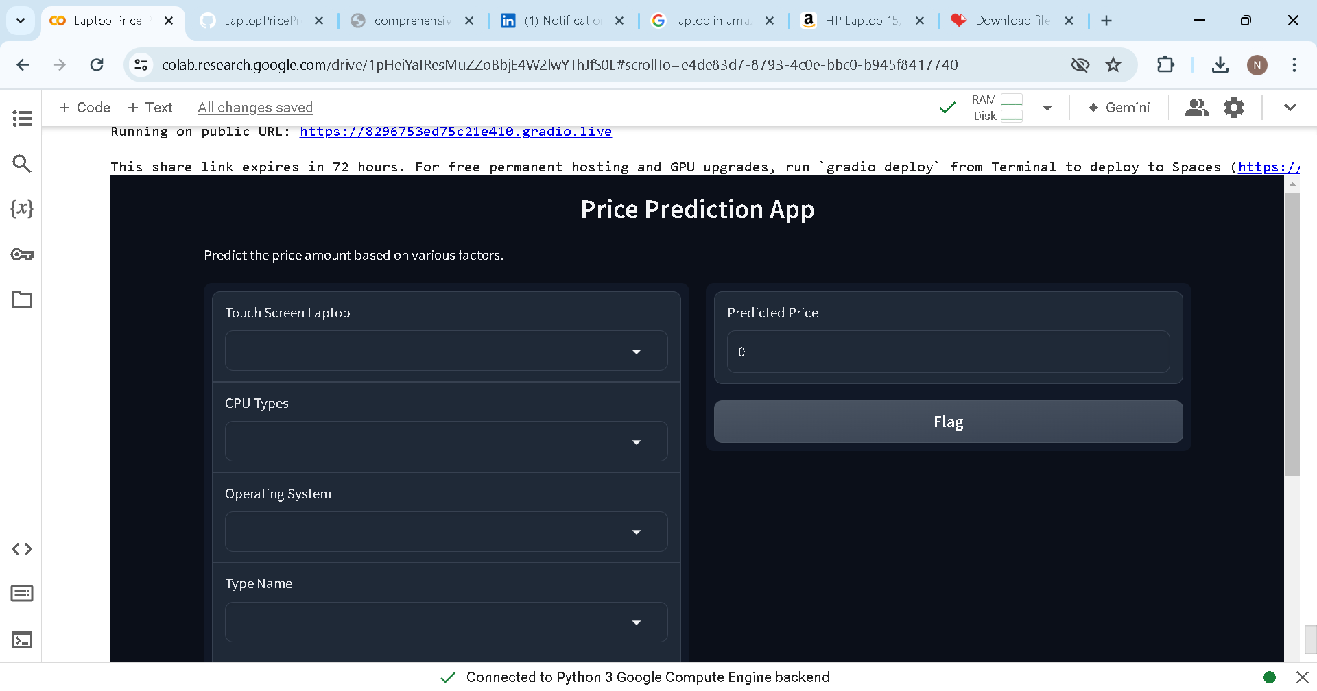
GRADIO APP FOR REAL-TIME PREDICTIONS

Slide 31
CHALLENGES FACED
Ensuring project quality while iterating on data pre- processing, model training, and evaluation phases
Dealing with missing values, categorical variables, and feature engineering which required careful handling and informed
decision-making
Choosing the most suitable algorithms among various options, considering their interpretability, and computational
complexity

Slide 32







BUSINESS QUESTIONS
The features with the most significant impact on laptop prices, according to the model's insights, include whether the laptop has a touchscreen, the type of CPU, the operating system (OS), the laptop type, the brand, RAM capacity, and pixel density (PPI).
The model can predict the prices of laptops from lesser-known brands that are present in the dataset like Fujitsu and Vero.
The brand of the laptop significantly influences its price, with Razer laptops being the most expensive, followed by other mid-range brands like Lenovo, Dell, Asus, Acer, and HP. Lesser-known brands may offer more competitively priced options
High-end features include Gaming and Ultrabook categories, Intel Core i7 processors, laptops with touchscreen features, Nvidia GPUs, and Mac OS. These features are associated with higher pricing and are considered premium options compared to budget alternatives like Notebook laptops with Intel Core i5
processors and Windows OS. The model performs reasonably well on both categories.
Limitations and challenges in predicting laptop prices accurately can be changes in market trends or consumer preferences over time, and the complexity of factors influencing laptop prices beyond the features
included in the model.
The model struggles when predicting the prices of newly released laptops not present in the training dataset as it lacks historical data on those specific models.

Slide 33


RECOMMENDATIONS
Consider expanding the brand portfolio to include lesser-known brands like Fujitsu and Vero to offer more competitively priced options
Invest in marketing efforts targeting high-end segments, emphasizing features like Gaming and Ultrabook categories, and Intel Core i7 processors, to capitalize on their association with premium pricing
Stay updated on market trends and consumer preferences to
adapt pricing strategies accordingly
Educate customers on the value proposition of high-end features, highlighting their benefits in terms of performance, durability, and user experience to justify premium pricing and increase willingness to pay
Continuously benchmark prices against competitors, particularly mid-range brands like Lenovo, Dell, Asus, Acer, and HP, to ensure
competitiveness while maintaining profitability
Consider promotional pricing strategies to stimulate demand
and capture market share

Slide 34

FUTURE SCOPE
Explore the implementation of other machine learning models such as XGBoost or Gradient Boosting Machines to enhance the accuracy and robustness
Investigate deep learning architectures such as recurrent neural networks (RNNs) or long short- term memory (LSTM) networks to uncover complex relationships
Refine the model to predict emerging features' impact on laptop prices

Slide 35
THANK YOU
Hope you liked it.

